Slide 1
Distributed SQL : Introduction
A Distributed SQL database automatically distributes and strongly replicates data so that SQL can be executed against it, in a distributed and ACID compliant manner.
What is distributed SQL?
SQL API
Distributed data storage
Strongly consistent replication
Distributed query execution
Distributed Acid transaction

Slide 2
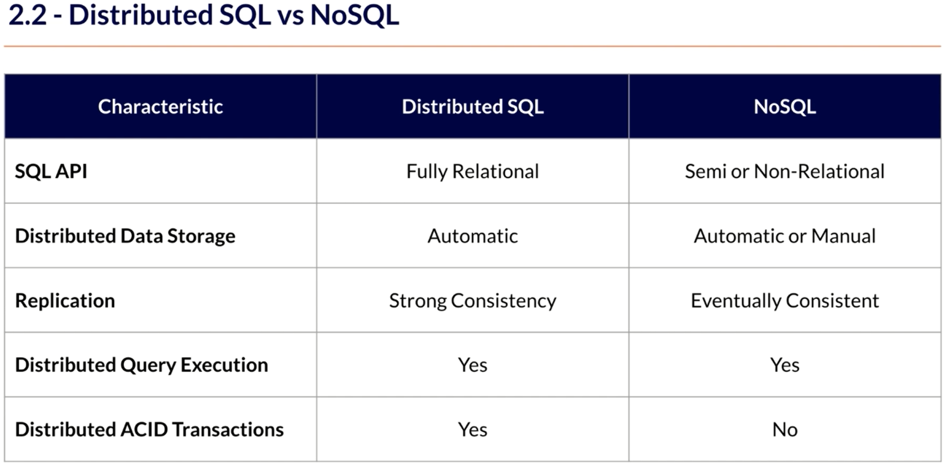
Distributed SQL : Compare with NoSQL

Slide 3
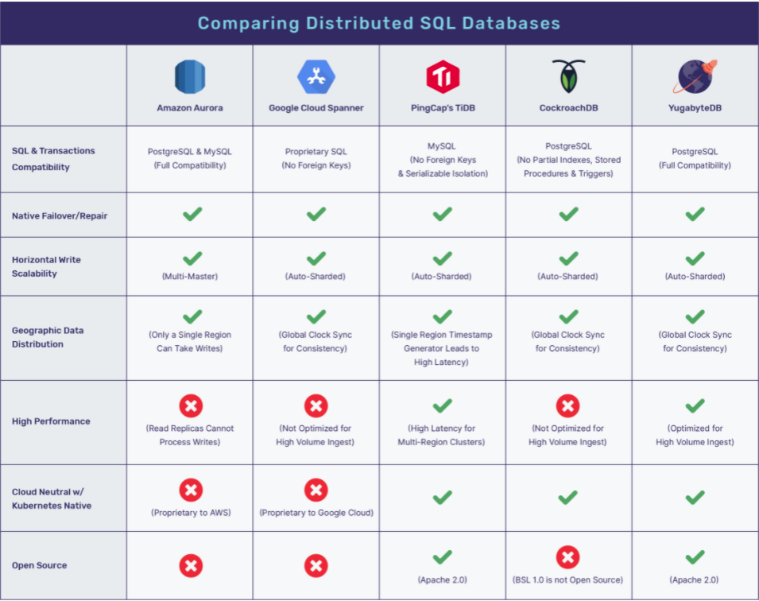
Distributed SQL : Compare across Distributed SQL

Slide 4
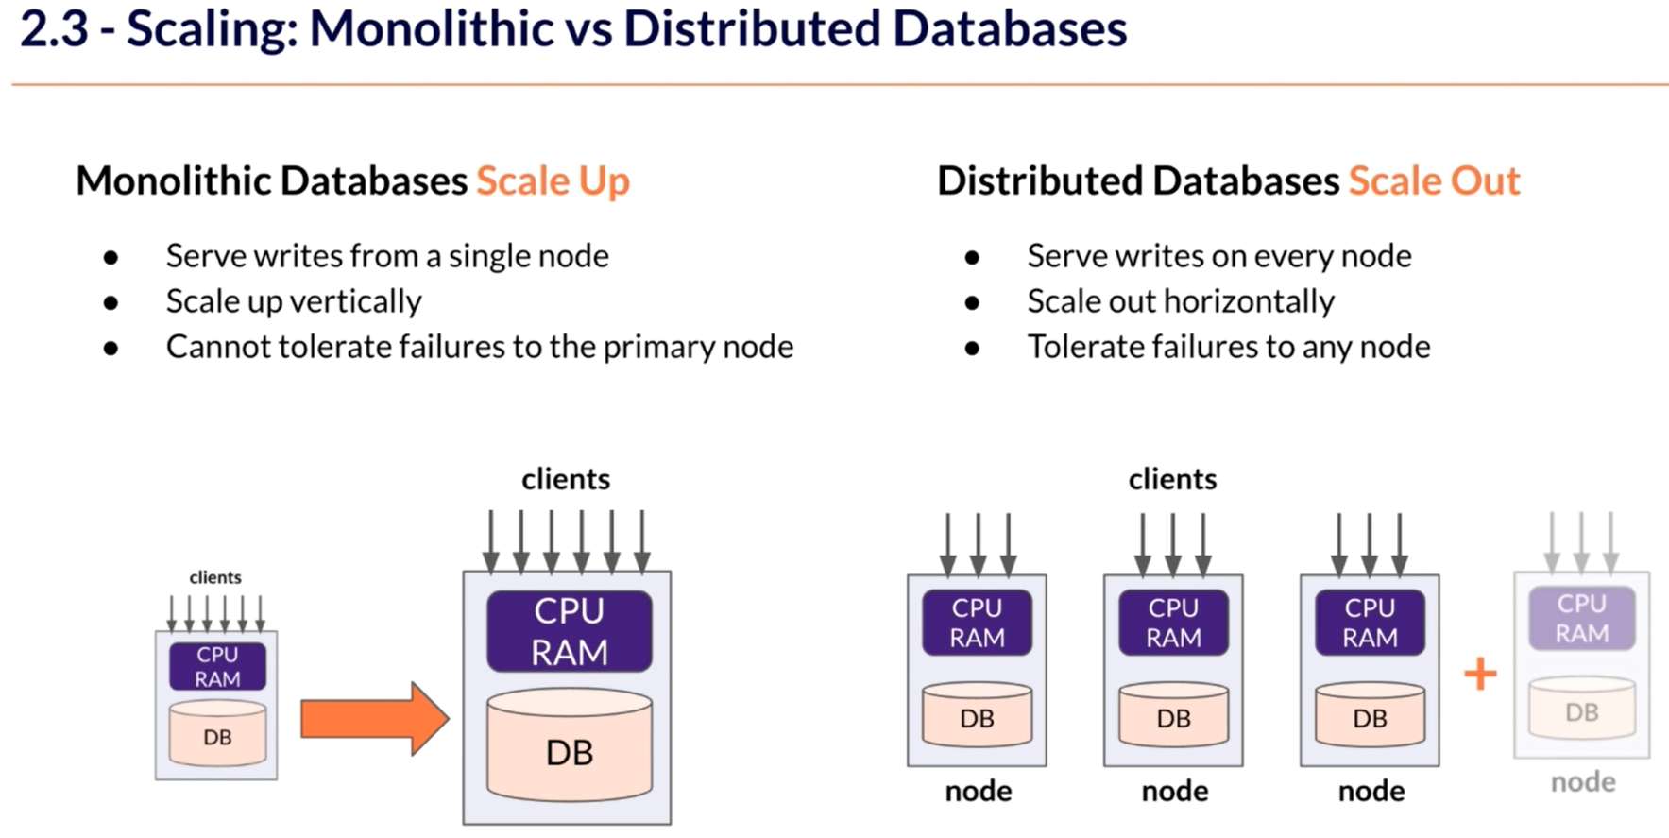
Distributed SQL : Understanding Scaling

Slide 5
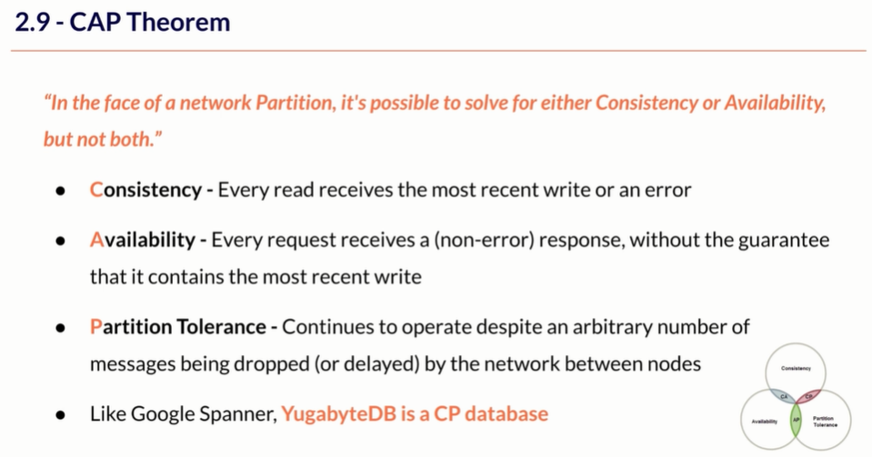
Distributed SQL : CAP theorem for YugabyteDB

Slide 6
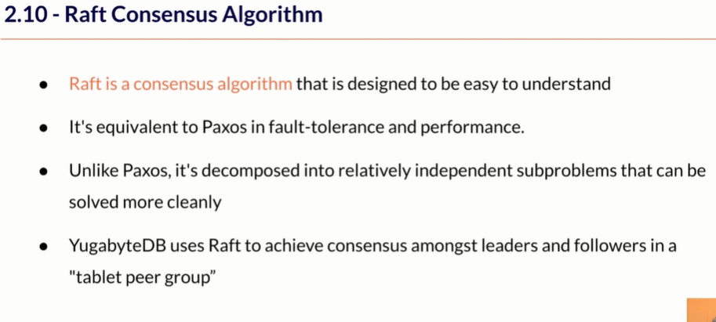
Distributed SQL : Raft consensus algorithm for YugabyteDB

Slide 7
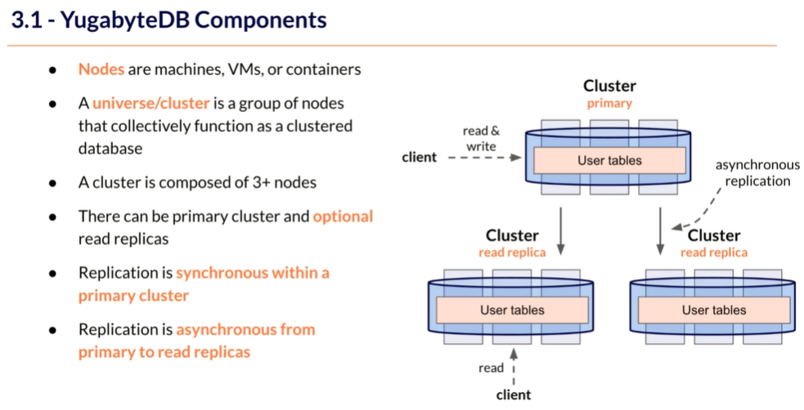
Distributed SQL : Components for YugabyteDB

Slide 8
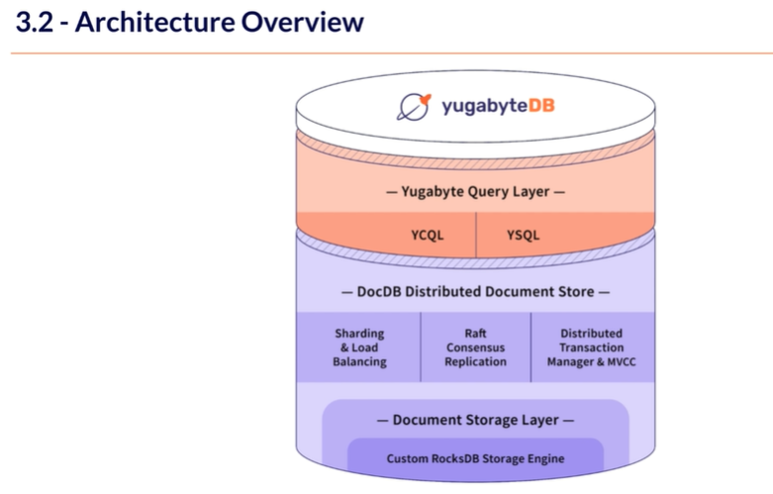
Distributed SQL : Architecture overview for YugabyteDB

Slide 9
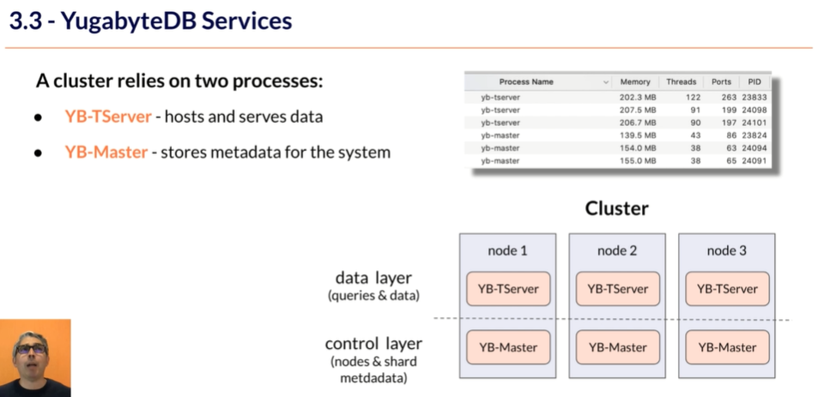
Distributed SQL : Frontline service view for YugabyteDB

Slide 10
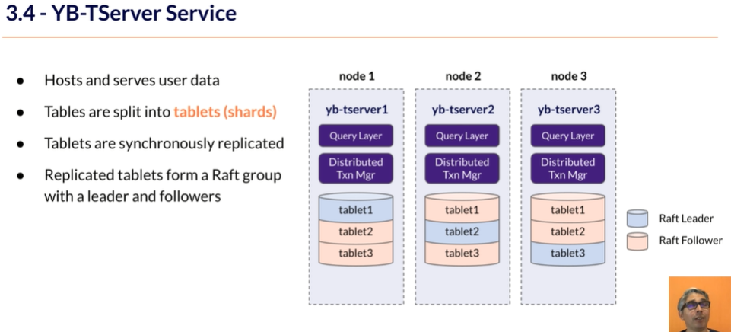
Distributed SQL : YB-TServer service for YugabyteDB

Slide 11
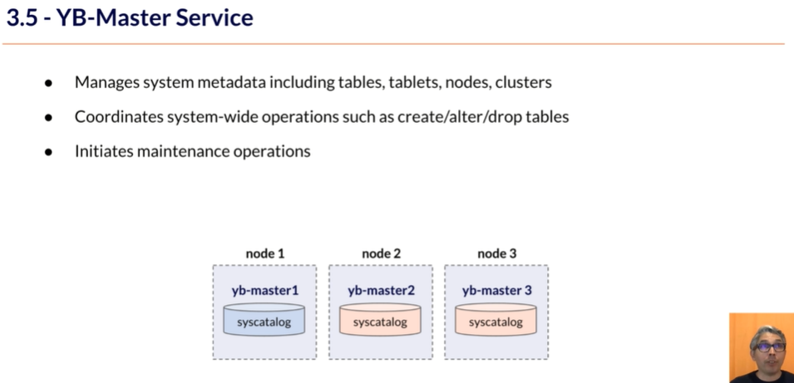
Distributed SQL : YB-Master service for YugabyteDB

Slide 12
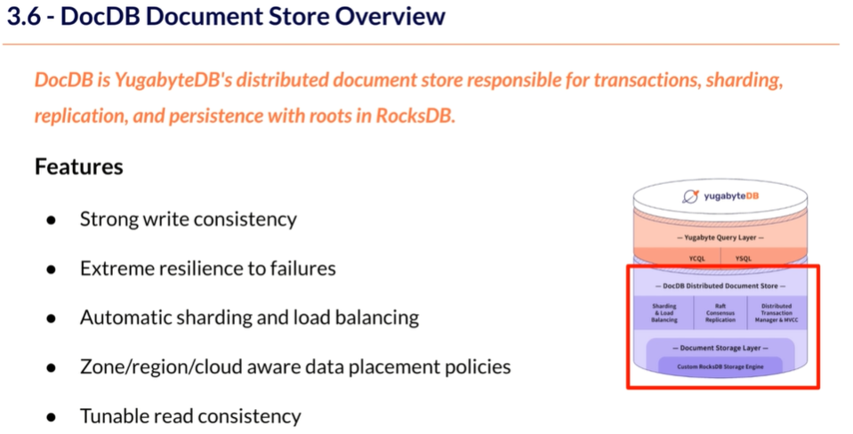
Distributed SQL : YB-Master service for YugabyteDB

Slide 13
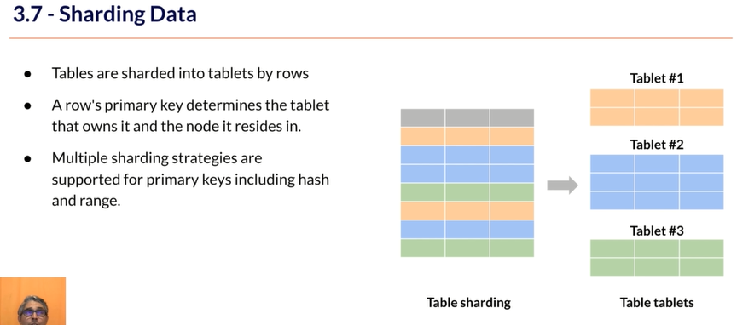
Distributed SQL : Sharding Approach for YugabyteDB

Slide 14
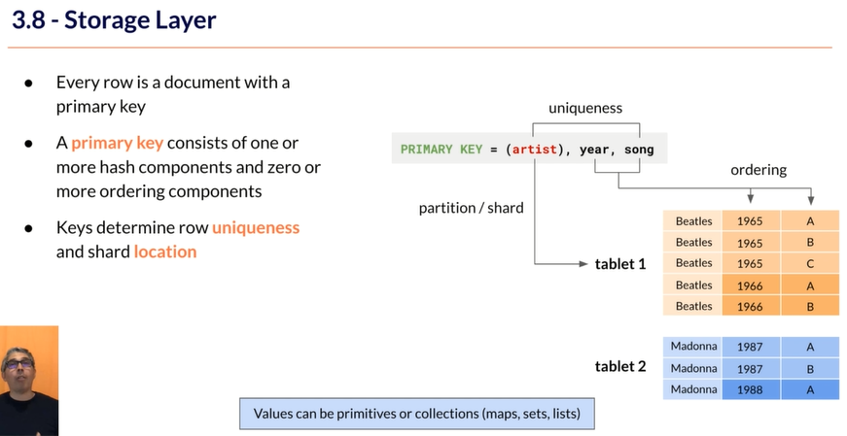
Distributed SQL : Storage Layer for YugabyteDB

Slide 15
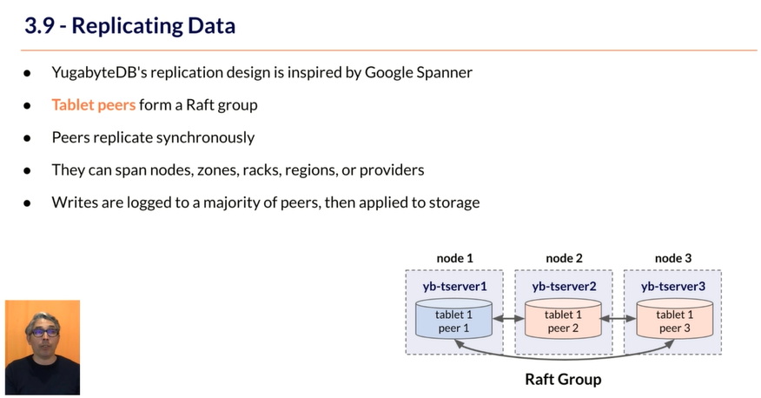
Distributed SQL : Replication approach for YugabyteDB

Slide 16
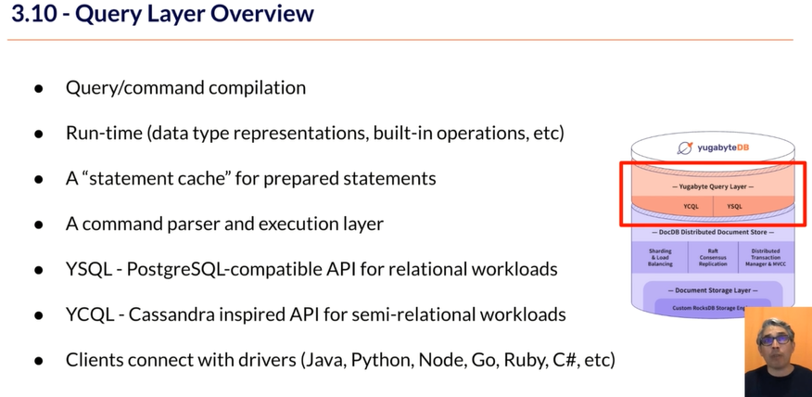
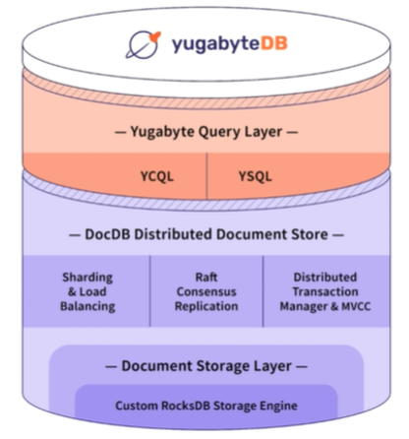
Distributed SQL : Understanding Query Layer for YugabyteDB

Slide 17
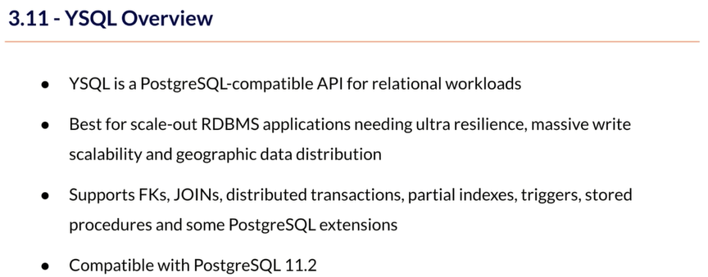
Distributed SQL : Understanding YSQL for YugabyteDB

Slide 18
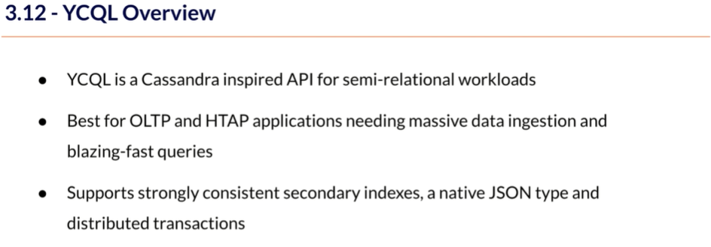
Distributed SQL : Understanding YCQL for YugabyteDB

Slide 19
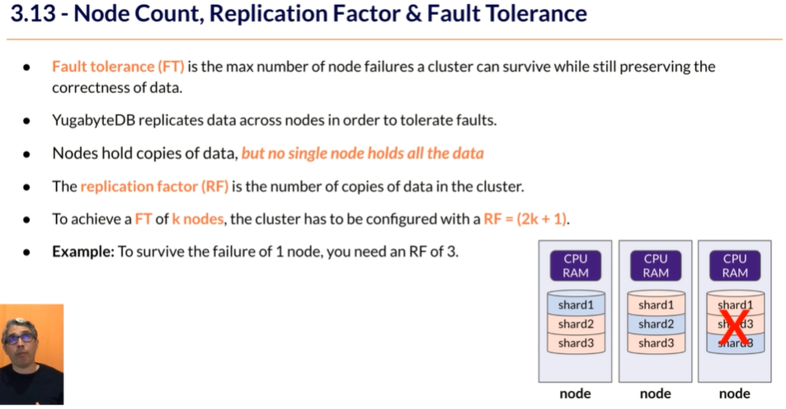
Distributed SQL : Understanding of resilience for YugabyteDB

Slide 20
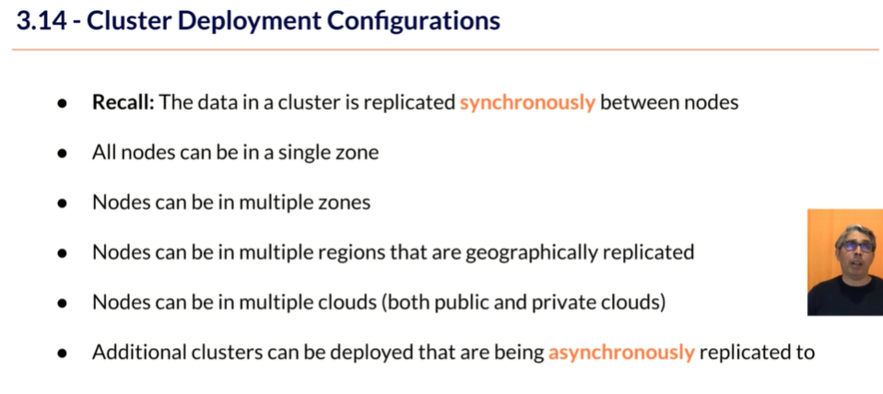
Distributed SQL : Understand Cluster deployment for YugabyteDB

Slide 21
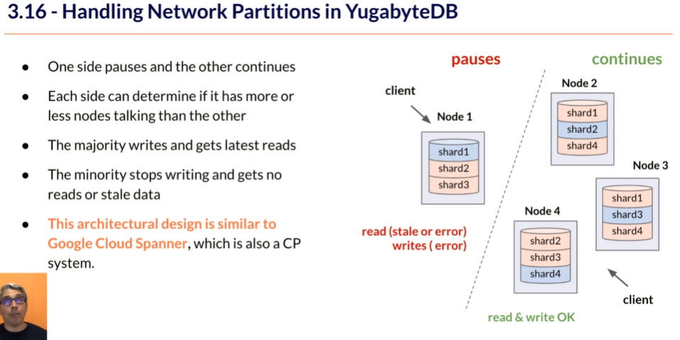
Distributed SQL : Handling of Network partition for YugabyteDB

Slide 22
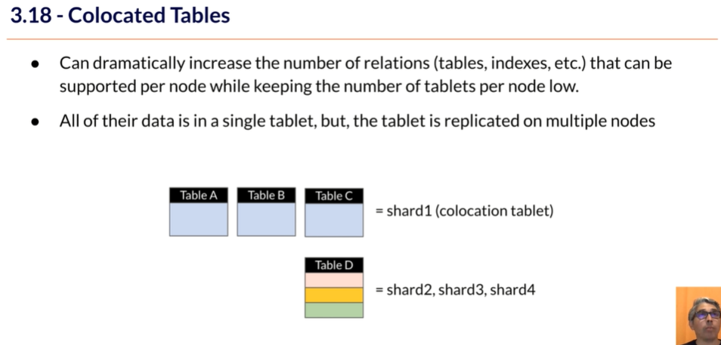
Distributed SQL : Handling of Collocated Table for YugabyteDB

Slide 23
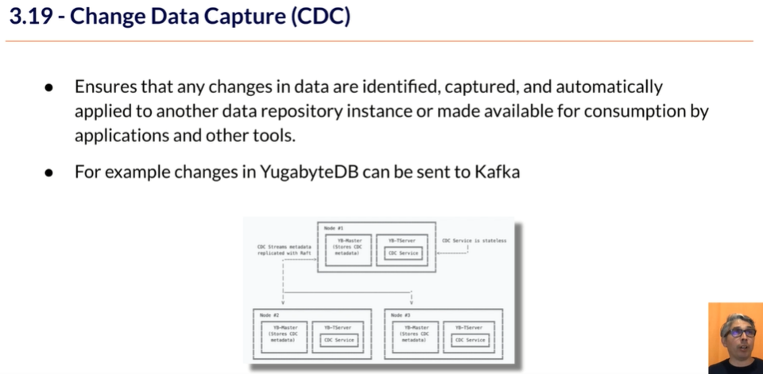
Distributed SQL : Understanding of Change Data Capture for YugabyteDB

Slide 24
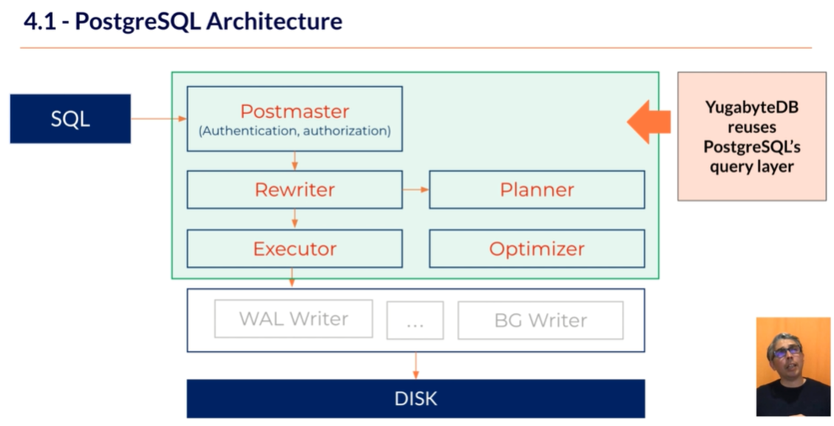
Distributed SQL : Understanding of PostgreSQL architecture for YugabyteDB

Slide 25
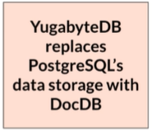
Distributed SQL : PostgreSQL data storage replaced with DocDB for YugabyteDB
YugabyteDB
Node
…
YugabyteDB
Node
YugabyteDB
Node
…

Slide 26
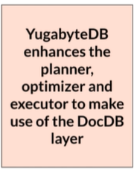
Distributed SQL : PostgreSQL architecture components with modification for YugabyteDB
YugabyteDB
Node
…
YugabyteDB
Node
YugabyteDB
Node
…

Slide 27
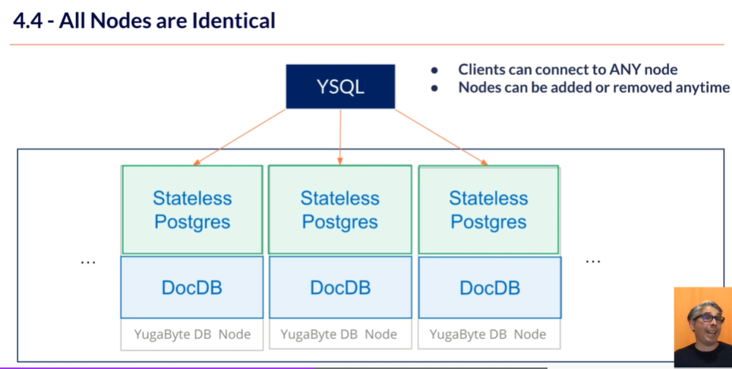
Distributed SQL : Stateless PostgreSQL for YugabyteDB

Slide 28
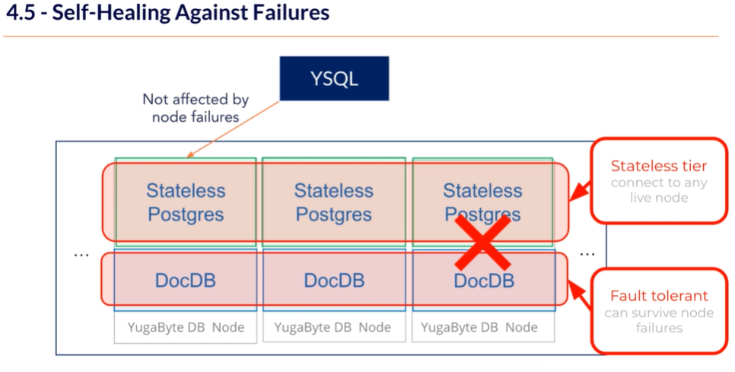
Distributed SQL : Self healing of nodes for YugabyteDB

